Slide 1
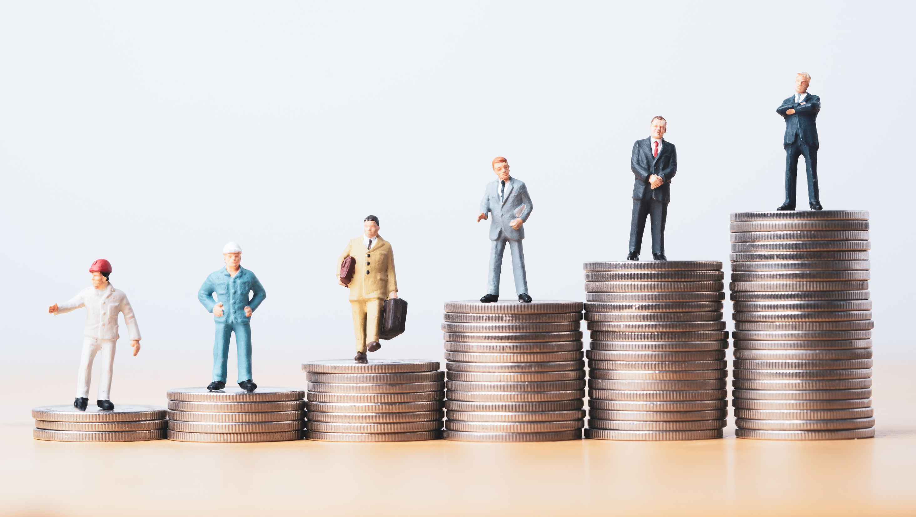
SOCIAL STRATIFICATION EQUALITY AND EQUITY
GNED 500
Week 11
Photo by Vecteezy
Notes:
SOCIAL STRATIFICATION EQUALITY AND EQUITY

Slide 2

AGENDA
Wage Gap
Gender Wage Gap
Inequality
Social Inequality
Class
Factors that Produce Social Inequality
Barriers
Ideologies
Social Stratification
Power and Privilege
Social Stratification & Global Citizenship
The 3 Forms of Capital
Social Class Model
Wealth Gap Inequality
Global Inequality
Global Stratification
Image by Shahid Abdullah from Pixabay
Notes:
Wage Gap
Gender Wage Gap
Inequality
Social Inequality
Class
Factors that Produce Social Inequality
Barriers
Ideologies
Social Stratification
Power and Privilege
Social Stratification & Global Citizenship
The 3 Forms of Capital
Social Class Model
Wealth Gap Inequality
Global Inequality
Global Stratification

Slide 3

LEARNING OUTCOMES
Students will learn and should be able to:
Identify/recognize what gives one power and privilege
Recognize that power and privilege are contextual
Identify the three forms of capital
Understand the concept of social stratification
Analyze the intersection of power and privilege and social stratification
LEARNING
OUTCOMES
Vector by pch.vector - freepik.com
Notes:
Students will learn and reliably demonstrate the ability to:
Differentiate between equity and equality
Understand the roots of colonialism and how it leads to internalized colonization
Examine the issue of race in relation to equity
Understand deficit thinking, meritocracy, neoliberalism, and tokenism
Recognize that power and privilege are contextual

Slide 4
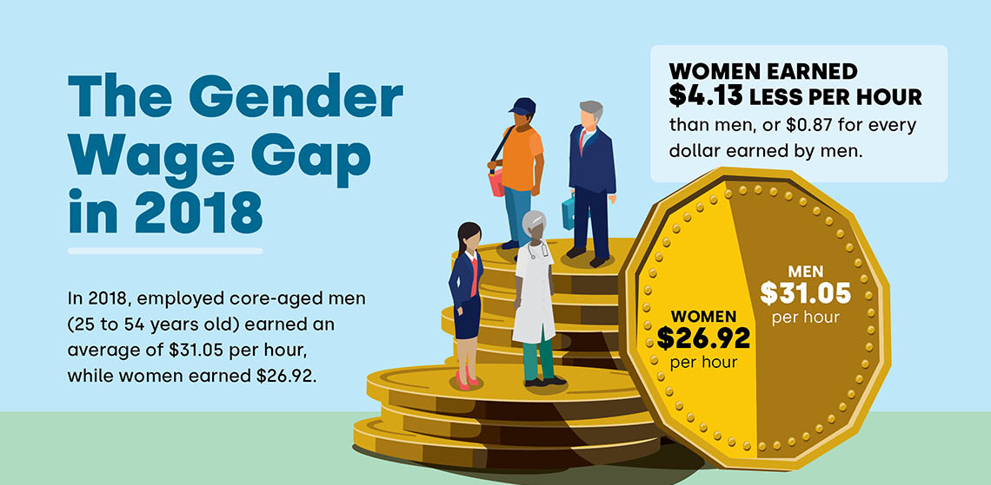
WAGE GAP
Infographic By Statistics Canada
Notes:
Job experience VS degree, need more details e.g. more woman on child education, which is lower in wage
This study from 2014 compares the wages of full-time public and private sector workers and finds significant gaps in the wages of women, aboriginal workers, and visible minority workers—and that those gaps are bigger in the private sector in every instance .
Since 2014 the gap has only continued to widen and remains a concern for Canadian Society
Narrowing the Gap - 2014 Study
https://policyalternatives.ca/sites/default/files/uploads/publications/National%20Office/2014/10/Narrowing_the_Gap.pdf
https://www150.statcan.gc.ca/n1/pub/11-627-m/11-627-m2019065-eng.htm
https://policyalternatives.ca/publications/facts-infographics/infographic-canadas-pay-gap
https://canadianwomen.org/the-facts/the-gender-pay-gap/

Slide 5
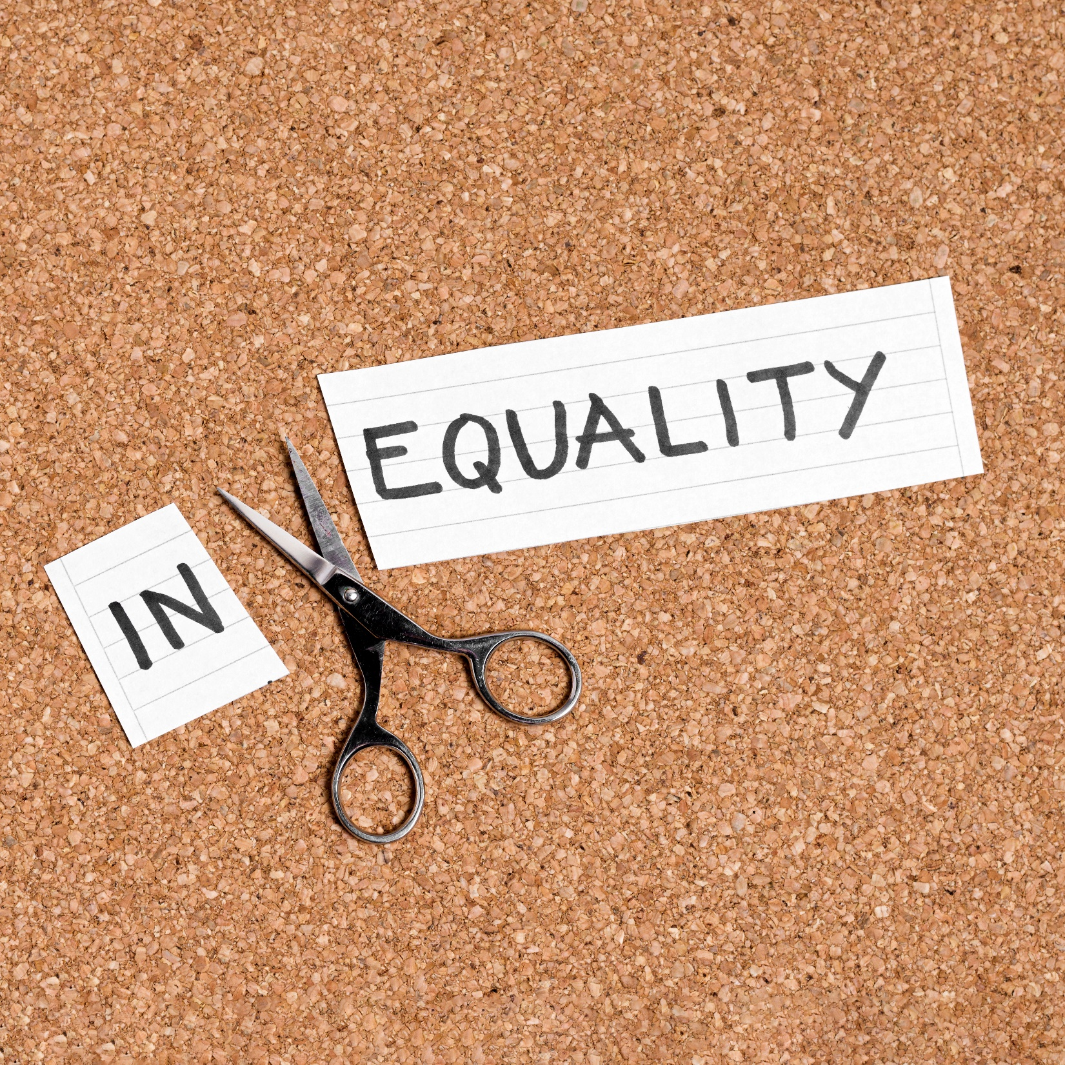
Inequality
What words, images, ideas, examples come to mind when you hear the word “inequality”?
Photo by Vecteezy
Notes:
Equal → based on what matrix? Due with nuclear and child education should have same salary?
What words, images, ideas, examples come to mind when you hear the word “inequality”?

Slide 6
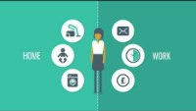
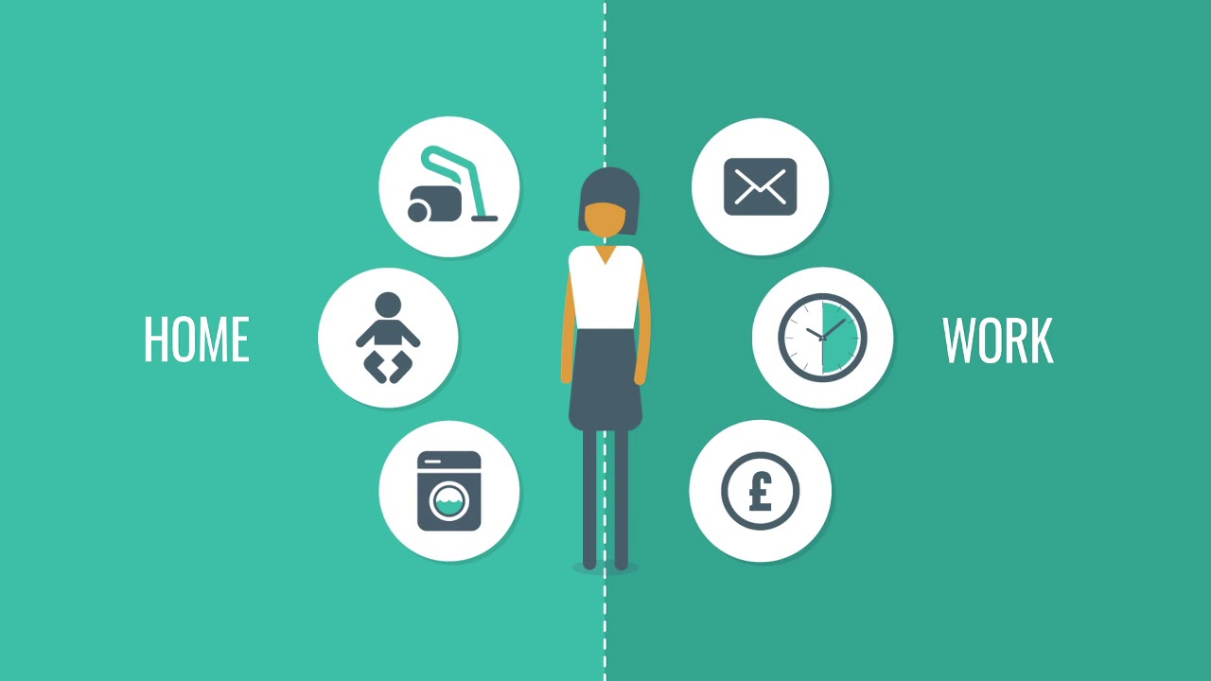
Notes:
https://youtu.be/F8vGXqzcxm8 A short animation on the causes of the gender pay gap. The pay gap harms women, men, and the economy. It's up to all of us to close the gap.

Slide 7
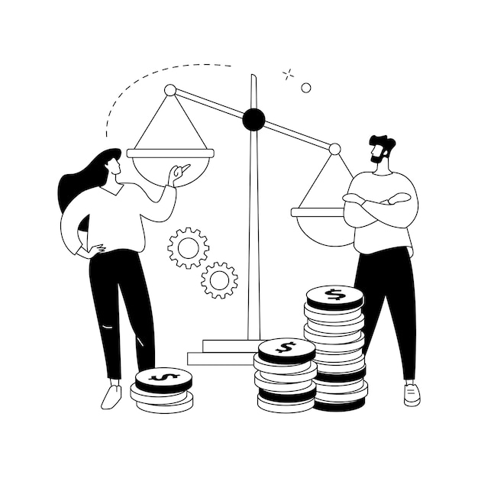
Inequality
Inequality:
The quality of being unequal or uneven as: a lack of evenness; social disparity; disparity of distribution or opportunity (http://www.merriam-webster.com/dictionary/inequality).
Thus, inequality is when two or more things are not the same.
Inequalities exist everywhere and always. Our task, as critical thinkers, is to question why these inequalities exist.
From there we can begin to ask whether these inequalities should exist.
Particularly, we must pay attention to the creation and persistence of social inequalities.
Graphic by vectorjuice - freepik.com
Notes:
Photo is steriotype
Inequality:
The quality of being unequal or uneven as: a lack of evenness; social disparity; disparity of distribution or opportunity (http://www.merriam-webster.com/dictionary/inequality).
Thus, inequality is when two or more things are not the same.
Inequalities exist everywhere and always. Our task, as critical thinkers, is to question why these inequalities exist.
From there we can begin to ask whether these inequalities should exist.
Particularly, we must pay attention to the creation and persistence of social inequalities.

Slide 8
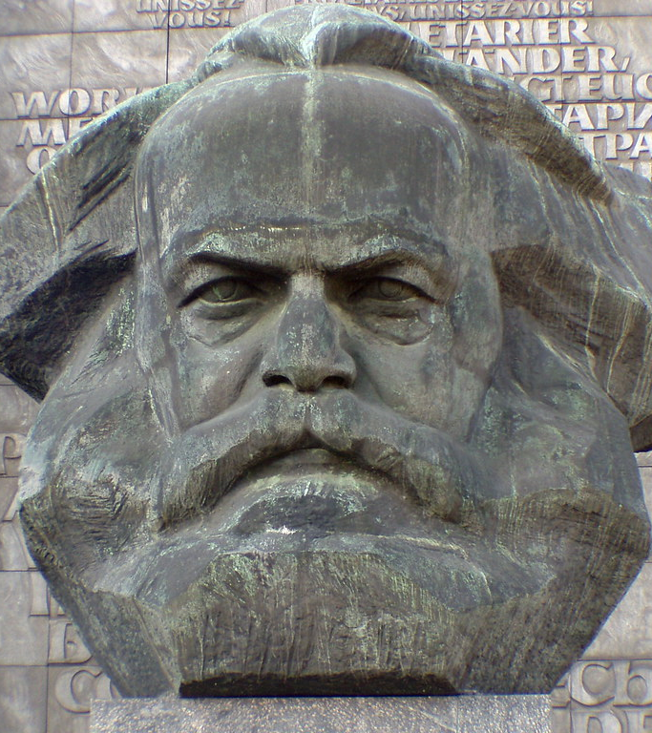
SOCIAL INEQUALITY
Karl Marx believed that capitalism’s inequalities arise from the deeply rooted class divisions between the bourgeoisie haves (the rich) and proletarian have-nots (the poor
Karl-Marx-Monument in Chemnitz by Einsamer Schütze -CC BY-SA 4.0
Notes:
Karl Marx believed that capitalism’s inequalities arise from the deeply rooted class divisions between the bourgeoisie haves (the rich) and proletarian have-nots (the poor

Slide 9
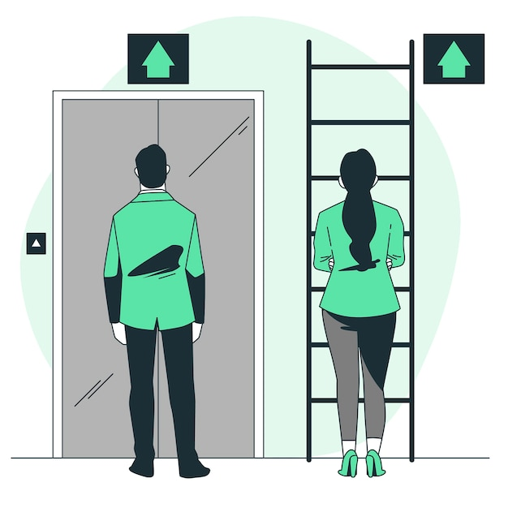
Social Inequality
Social Inequality: The difference in the treatment of people on the basis of their social status (class, gender, age, ability, race, ethnicity, citizenship, etc.). It generally involves restricting people’s full participation in society and limiting resources and opportunities; hence, affecting overall quality of life.
Thinking about social inequality means thinking beyond individuals. It means thinking about the larger patterns that divide groups, positioning some as superior and others as inferior.
We must ask whether certain social inequalities are natural or whether they are the result of other factors including unequal opportunity and exploitation.
Grphic by storyset - freepik.com
Notes:
e.g. class with most man not woman, woman maybe more difficult
Social Inequality: The difference in the treatment of people on the basis of their social status (class, gender, age, ability, race, ethnicity, citizenship, etc.). It generally involves restricting people’s full participation in society and limiting resources and opportunities; hence, affecting overall quality of life.
Thinking about social inequality means thinking beyond individuals. It means thinking about the larger patterns that divide groups, positioning some as superior and others as inferior.
We must ask whether certain social inequalities are natural or whether they are the result of other factors including unequal opportunity and exploitation.

Slide 10

Class
Class refers to the relative location of a person or group within a larger society based on wealth, power, prestige, or other valued resources.
Class determines one’s access to rewards, resources, and opportunities which, in turn, influence one’s level of education, income, occupation, housing, health care, and life expectancy.
Traditionally, class has been divided into five categories: upper class; middle class; working class; working poor; underclass.
Photo by Vecteezy
Notes:
Class refers to the relative location of a person or group within a larger society based on wealth, power, prestige, or other valued resources.
Class determines one’s access to rewards, resources, and opportunities which, in turn, influence one’s level of education, income, occupation, housing, health care, and life expectancy.
Traditionally, class has been divided into five categories: upper class; middle class; working class; working poor; underclass.

Slide 11

BREAK
Photo by Hannah Tims on Unsplash
Notes:
15 Minute Break
This slide can be moved to where you have your class break(s)

Slide 12
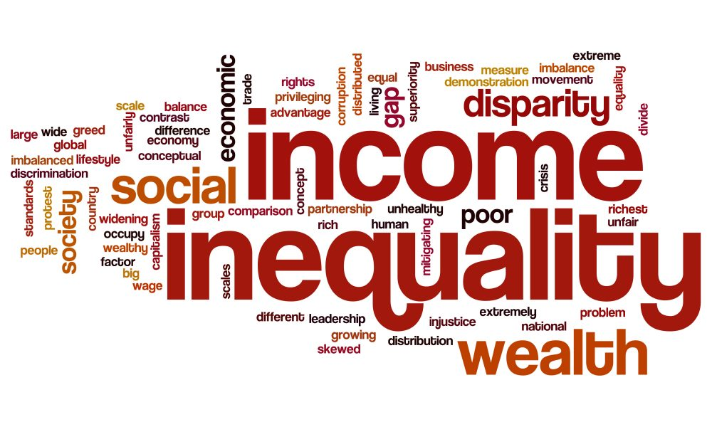
4 factors that produce social inequality
Over the next two units, we will look at four factors that produce and structure social inequality.
The are:
Barriers
Ideologies
Social Stratification
Power & Privilege
Image by narciso1 from Pixabay
Notes:
Over the next two units, we will look at four factors that produce and structure social inequality.
The are:
Barriers
Ideologies
Social Stratification
Power & Privilege

Slide 13
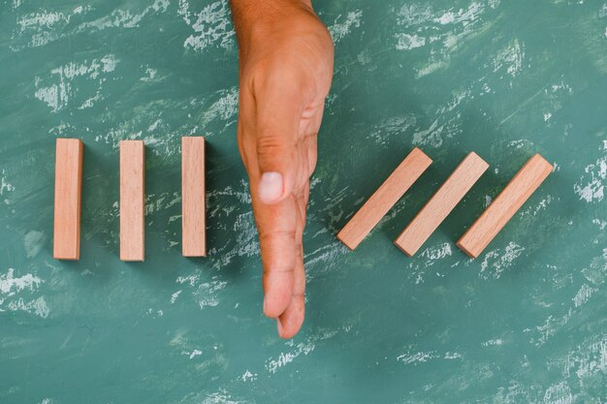
BARRIERS
Barriers are policies or practices that prevent full and equal participation in society.
Barriers can be physical, social, attitudinal, organizational, technological or informational.
Barriers prevent or limit people from achieving equality in society
They can be visible or invisible.
Photo by 8photo - freepik.com
Notes:
Barriers are policies or practices that prevent full and equal participation in society.
Barriers can be physical, social, attitudinal, organizational, technological or informational.
For example, for a visually impaired individual, a physical barrier in education may be the small font in a text or poor lighting in the classroom.
An attitudinal barrier may be the perception that a visual impairment also implies an intellectual impairment.
Barriers prevent or limit people from achieving equality in society and they can be visible or invisible.

Slide 14

BARRIERS: VISIBLE
Visible barriers include those public and private spaces that are literally inaccessible to individuals who have a physical disability.
For example, buildings or subway stations without wheelchair access pose a physically visible barrier to those who require access to them.
Visible barriers need not be only physical in form
For example, they can be policies designed to include some, while excluding others.
Canada’s immigration policy is designed based on a points system that benefits individuals with sufficient educational credentials, work experience, and knowledge of one of the official languages.
This policy is designed to allow some people in while keeping others out.
Image by storyset - freepik.com
Notes:
Visible barriers include those public and private spaces that are literally inaccessible to individuals who have a physical disability.
For example, buildings or subway stations without wheelchair access pose a physically visible barrier to those who require access to them.
Visible barriers need not be only physical in form.
For example, they can be policies designed to include some, while excluding others.
Canada’s immigration policy is designed based on a points system that benefits individuals with sufficient educational credentials, work experience, and knowledge of one of the official languages.
This policy is designed to allow some people in while keeping others out.

Slide 15
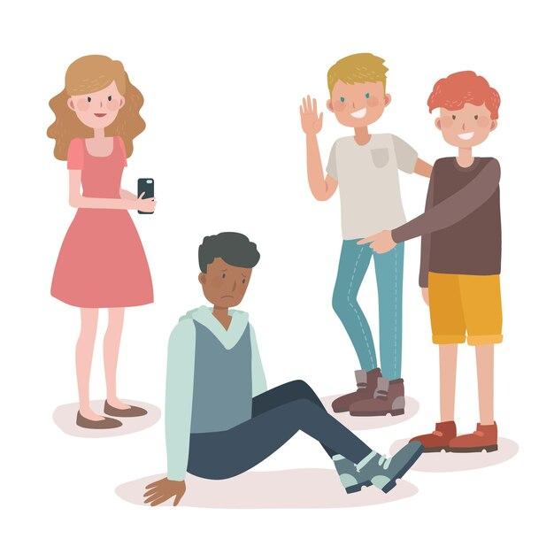
BARRIERS: INVISIBLE
Invisible barriers may not be formally outlined in law and policy but are maintained within social structures
For example, despite Canada’s immigration policy emphasizing the need for skilled internationally trained immigrants, many newcomers encounter significant difficulties accessing employment in their field.
The privileging of Canadian experience, the lack of networks, and outright racism and discrimination create a situation where many immigrants remain unemployed, underemployed, or forced to seek expensive re-training.
Prejudice Image by freepik.com
Notes:
Invisible barriers may not be formally outlined in law and policy but are maintained within social structures.
For example, despite Canada’s immigration policy emphasizing the need for skilled internationally trained immigrants, many newcomers encounter significant difficulties accessing employment in their field.
The privileging of Canadian experience, the lack of networks, and outright racism and discrimination create a situation where many immigrants remain unemployed, underemployed, or forced to seek expensive re-training.

Slide 16

Social Stratification
In most societies, different social groups are not all treated equally. They have been structured, organized and reinforced differently by the societies in which we live.
They have been divided through a process known as social stratification.
Social Stratification is the hierarchical arrangement of large social groups on the basis of their control over basic resources.
Usually, when we are talking about social stratification, we are talking about class, but social stratification also includes how class intersects with other statuses such as gender, race, sexuality, etc.
Graphic By vectorjuice – freepik.com
Notes:
In most societies, different social groups are not all treated equally. They have been structured, organized and reinforced differently by the societies in which we live.
They have been divided through a process known as social stratification.
Social Stratification is the hierarchical arrangement of large social groups on the basis of their control over basic resources.
Usually, when we are talking about social stratification, we are talking about class, but social stratification also includes how class intersects with other statuses such as gender, race, sexuality, etc.

Slide 17
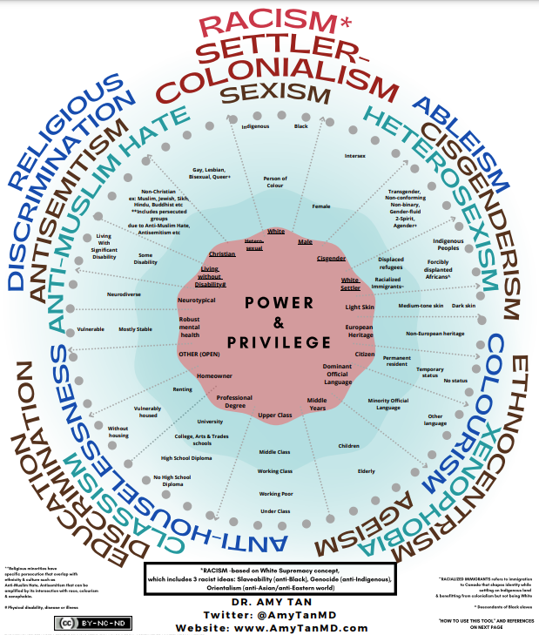
POWER & PRIVLEGE
Social stratification is created and maintained through power and privilege.
Power: The capacity to command resources and thereby to control social situations.
In a stratified system, dominant group members have the greatest degree of power, meaning they have the ability to make decisions, influence systems, and establish dominant ideologies.
They can use their position of power to develop laws and policies that work in their favour and sway public views and principles to uphold their agendas.
Privilege allows these dominant groups to maintain and pass on this control to others like them.
Power & Privilege in Canada Graphic Dr Amy Tan MD Creative Commons Attribution 4.0 International License
Notes:
Social stratification is created and maintained through power and privilege.
Power: The capacity to command resources and thereby to control social situations.
In a stratified system, dominant group members have the greatest degree of power, meaning they have the ability to make decisions, influence systems, and establish dominant ideologies.
They can use their position of power to develop laws and policies that work in their favour and sway public views and principles to uphold their agendas.
Privilege allows these dominant groups to maintain and pass on this control to others like them.
See the infographic by Dr Amy Tan
www.amytanMD.com
Racism Based on White supremacy concept which includes the three racist ideologies including
Slaveability (Anti-Black Racism)
Genocide (Anti-Indigenous Racism)
Orientalism (Anti-Asian/Anti Eastern World Racism)
Info:
https://amytanmd.com/2021/06/09/power-privilege-in-canada/

Slide 18
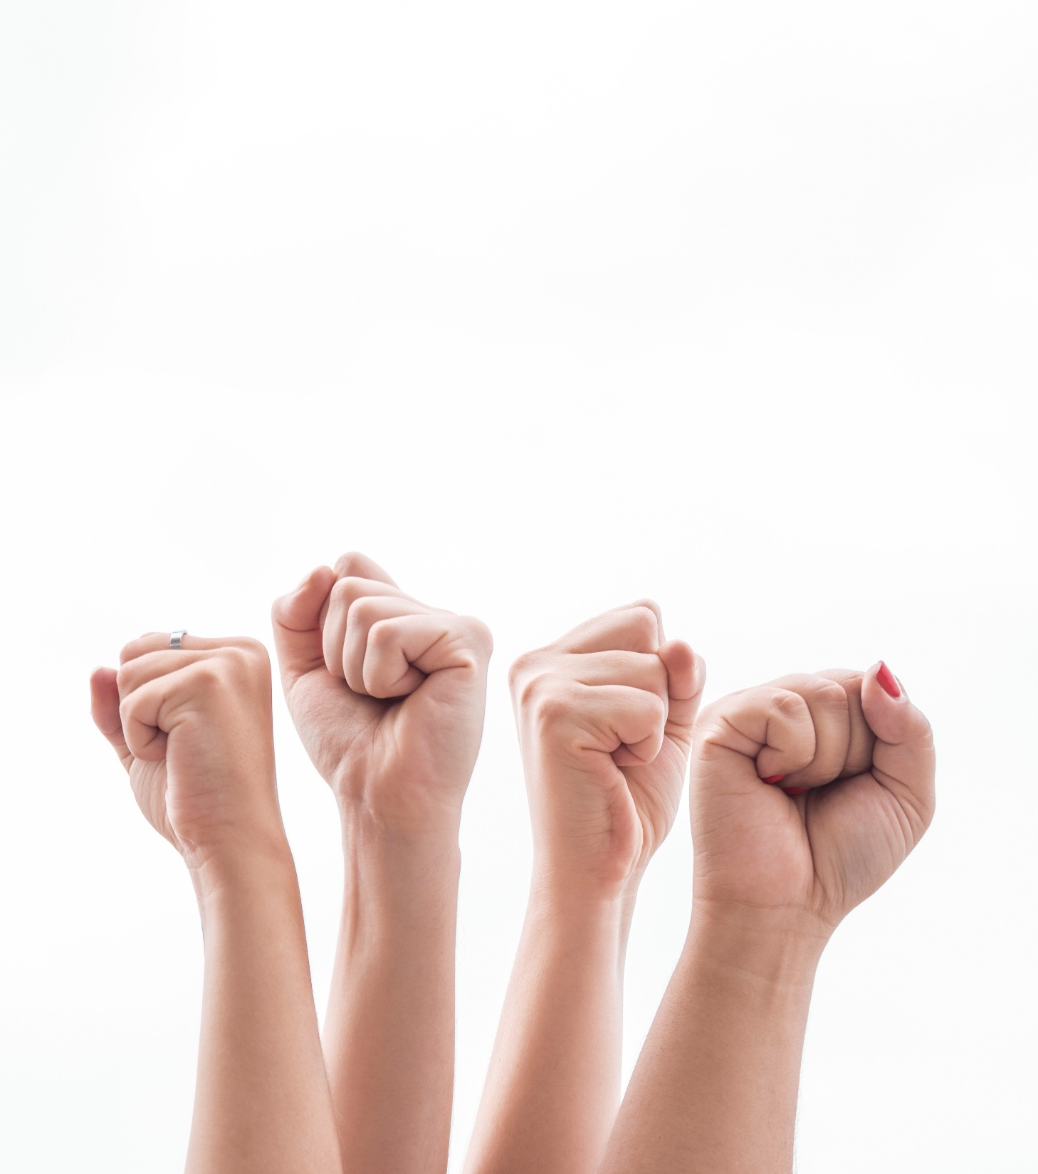
POWER & Privilege
The Haves vs. the Have-Nots
What does the severe lack of representation by women and racial and ethnic minorities tell you about who really has power and privilege in our country?
Photo by freepik.com
Notes:
Is not region?
What does the severe lack of representation by women and racial and ethnic minorities tell you about who really has power and privilege in our country?

Slide 19

Privilege
Gained through unearned power
gives dominant group members economic, social, and political advantages.
We call them privileges because they are rights, opportunities, or advantages that are not available to everyone equally.
The privilege is not deserved or attained due to hard work or achievement.
Rather, it is assumed merely because one belongs to a certain group.
Those who are privileged therefore have opportunities, resources, rights, choices, and freedoms that are categorically denied to others.
Privilege is often invisible except in cases where we do not have it.
Privilege is structured and maintained through capital.
Photo by Vecteezy
Notes:
Privilege: is gained through unearned power that gives dominant group members economic, social, and political advantage.
We call them privileges because they are rights, opportunities, or advantages that are not available to everyone equally.
The privilege is not deserved or attained due to hard work or achievement. Rather, it is assumed merely because one belongs to a certain group.
Those who are privileged therefore have opportunities, resources, rights, choices, and freedoms that are categorically denied to others.
Privilege is often invisible except in cases where we do not have it.
Privilege is structured and maintained through capital.

Slide 20
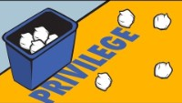

Notes:
https://youtu.be/2KlmvmuxzYE
With a recycling bin and some scrap paper students learn a powerful lesson about privilege
A simple, powerful exercise to teach your class about privilege and social mobility.

Slide 21
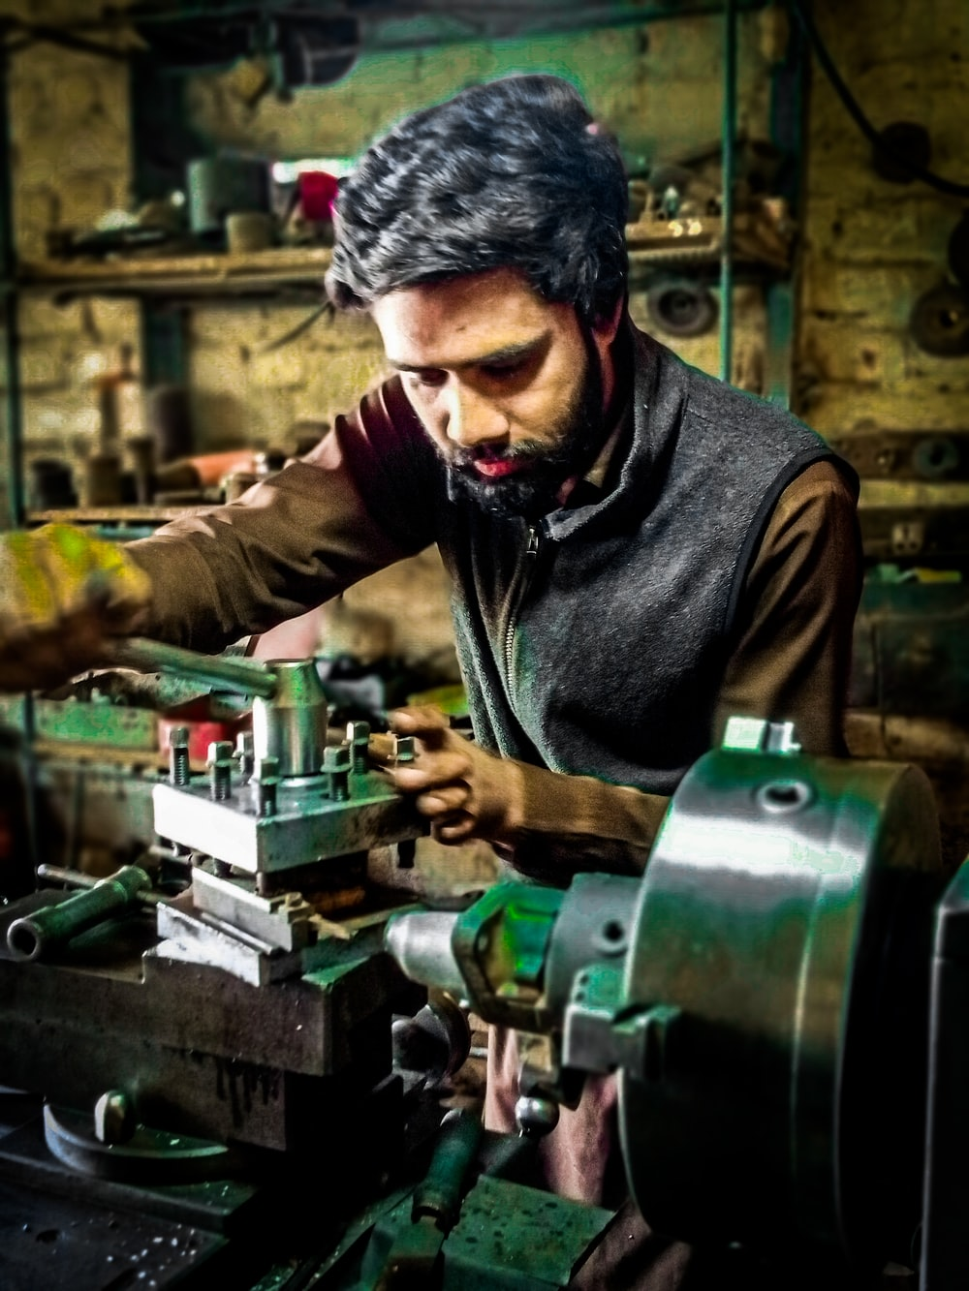
Social stratification & global citizenship
Social stratification doesn’t just happen. The following video looks at the garment industry in Bangladesh.
It shows us that global inequality is linked to patterns of globalization.
Corporations in search of cost savings and consumers in search of affordable products create pressure for cheap labour and unsafe working conditions.
Photo by ammar ahsan on Unsplash
Notes:
Social stratification doesn’t just happen. The following video looks at the garment industry in Bangladesh. It shows us that global inequality is linked to patterns of globalization. Corporations in search of cost savings and consumers in search of affordable products create pressure for cheap labour and unsafe working conditions.
CBC’s fifth estate: Made in Bangladesh - http://www.cbc.ca/player/Shows/Shows/the+fifth+estate/ID/2411701502/
[discussion questions – possibly link back to unit 1 on globalization?]

Slide 22

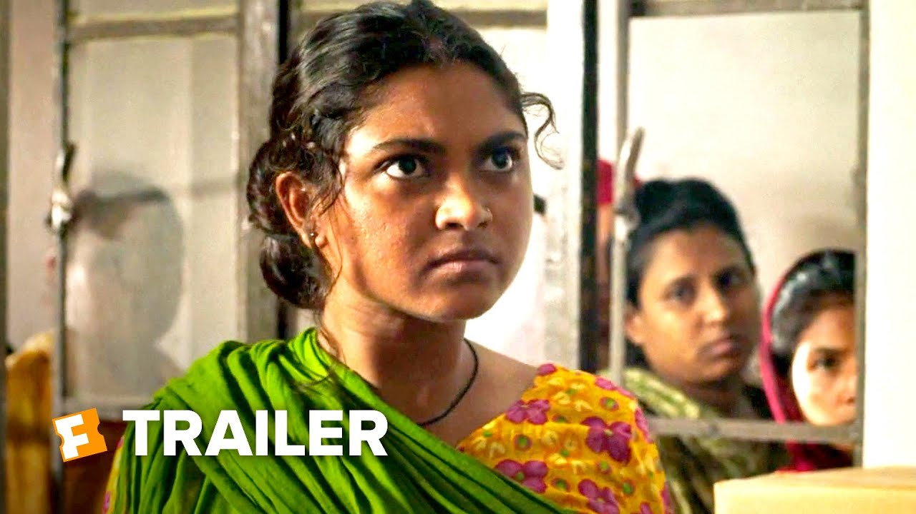
Notes:
Social stratification doesn’t just happen. The following video looks at the garment industry in Bangladesh. It shows us that global inequality is linked to patterns of globalization. Corporations in search of cost savings and consumers in search of affordable products create pressure for cheap labour and unsafe working conditions.
CBC’s fifth estate: Made in Bangladesh - http://www.cbc.ca/player/Shows/Shows/the+fifth+estate/ID/2411701502/
https://youtu.be/G4gyVRKxfm0

Slide 23
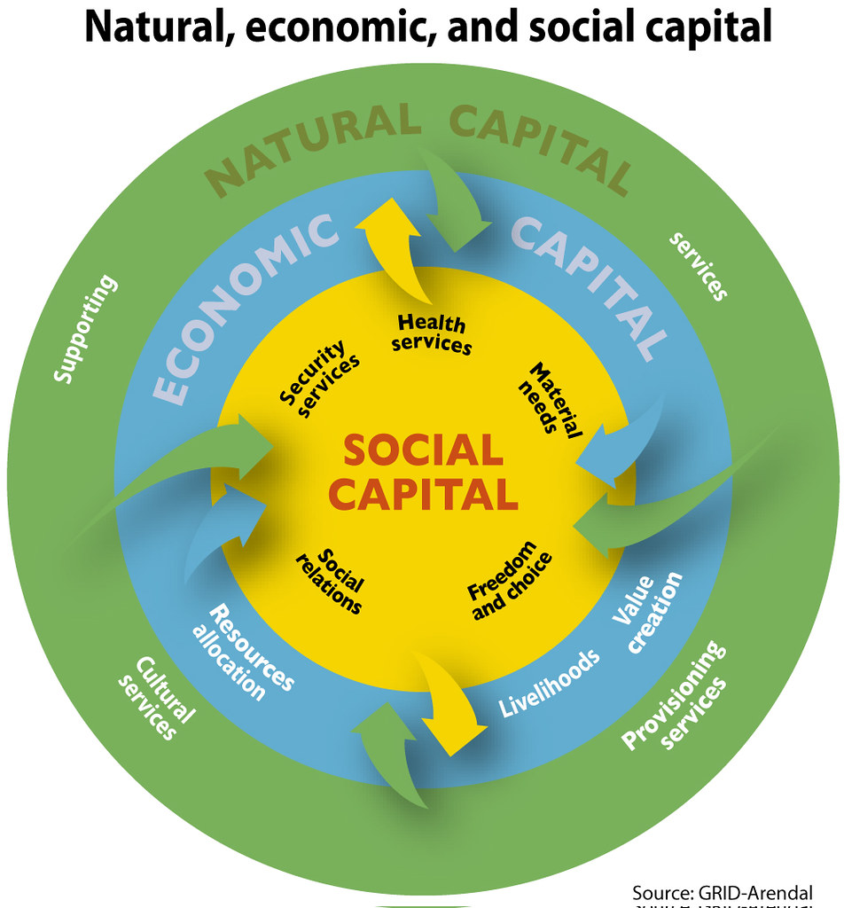
The 3 forms of capital
Three forms of capital work to structure the kind of privilege that gives some groups and individuals more opportunities and advantages.
They are…
economic capital
cultural capital
social capital
Image by GRID-Arendal
Notes:
Three forms of capital work to structure the kind of privilege that gives some groups and individuals more opportunities and advantages.
They are…
economic capital
cultural capital
social capital
https://www.grida.no/resources/6301

Slide 24
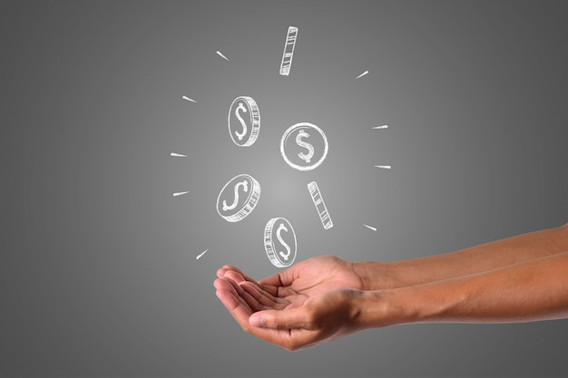
Economic capital
Economic capital is command over economic resources.
The more money you have access to, the more you are able to take advantage of rights and opportunities as they are presented to you.
Photo by Jcomp – Freepik.com
Notes:
Economic capital is command over economic resources.
The more money you have access to, the more you are able to take advantage of rights and opportunities as they are presented to you.

Slide 25

Cultural capital
Cultural capital is the type of knowledge, education, and skills that can give people a status that can lead to advantages.
But it is important to note that we are not talking about the kinds of knowledge, education, and skills that are relevant to a particular job. Instead, we are referring to having knowledge of or access to a particular culture that allows one to “fit in” with the types of people who can provide opportunities.
For example, claiming expertise in classical music or being an accomplished golfer is a form of cultural capital. It is a way of establishing your tastes as superior.
Image By jcomp – freepik.com
Notes:
Cultural capital is the type of knowledge, education, and skills that can give people a status that can lead to advantages.
But it is important to note that we are not talking about the kinds of knowledge, education, and skills that are relevant to a particular job. Instead, we are referring to having knowledge of or access to a particular culture that allows one to “fit in” with the types of people who can provide opportunities.
For example, claiming expertise in classical music or being an accomplished golfer is a form of cultural capital. It is a way of establishing your tastes as superior.

Slide 26

Social capital
Social capital refers to group memberships, networks, and relationships that give certain advantages in work and society.
Social capital is all about who you know and what they can do for you.
For example, how often do people get jobs based on having the right connections or knowing people already inside?
Connecting people by storyset - freepik.com
Notes:
Social capital refers to group memberships, networks, and relationships that give certain advantages in work and society.
Social capital is all about who you know and what they can do for you.
For example, how often do people get jobs based on having the right connections or knowing people already inside?

Slide 27
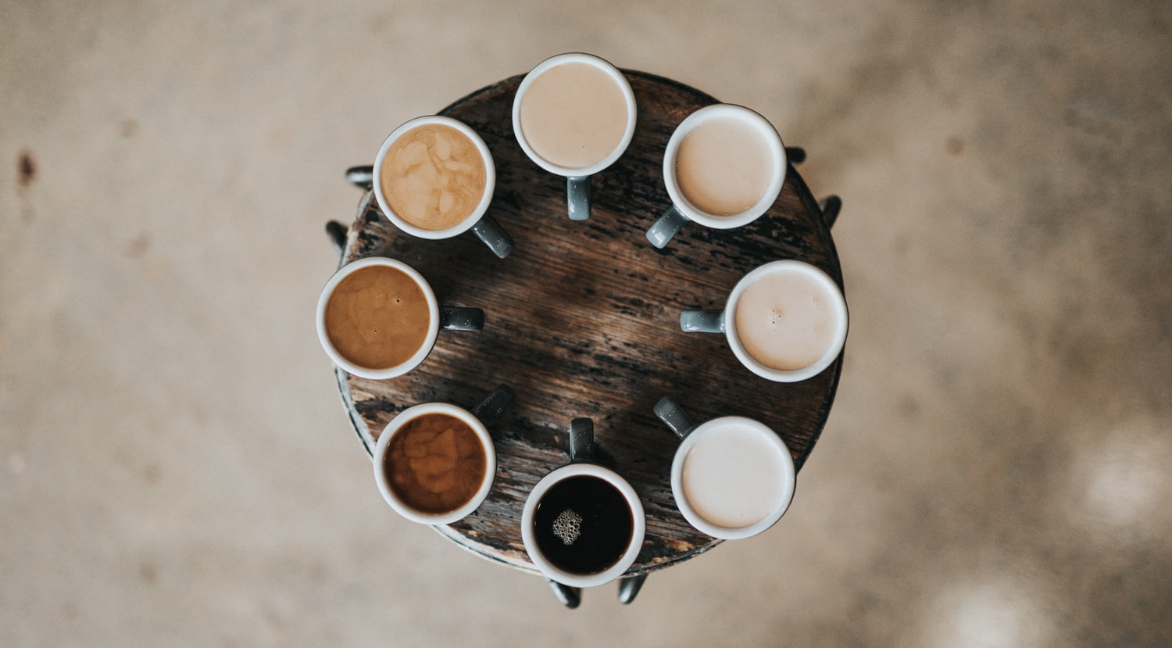
BREAK
Photo by Nathan Dumlao on Unsplash
Notes:
15 Minute Break
This slide can be moved to where you have your class break(s)

Slide 28


ATTENDANCE
ATTENDANCE MATTERS
Image by pch.vector - freepik.com
Notes:
This attendance slide can be moved to wherever in your class that you take attendance.
Usually attendance is taken around class breaks, or at the beginning or at the end of class.

Slide 29

Capital AS PRIVILEDGE
The following video demonstrates how these 3 forms of capital work together to privilege some members of a society.
How elite schools Convert Birthright into Credentials for Privileged students
What distinguishes these 3 forms?
How do they work together to provide unearned advantages and opportunities for certain groups?
Image by roserodionova - freepik.com
Notes:
The following video demonstrates how these 3 forms of capital work together to privilege some members of a society.
How elite schools Convert Birthright into Credentials for Privileged students: https://youtu.be/6ehzUdL8hCw
Identify instances in which Dr. Khan talks about cultural, economic, and social capital in the video.
What distinguishes these 3 forms?
How do they work together to provide unearned advantages and opportunities for certain groups?

Slide 30
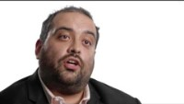
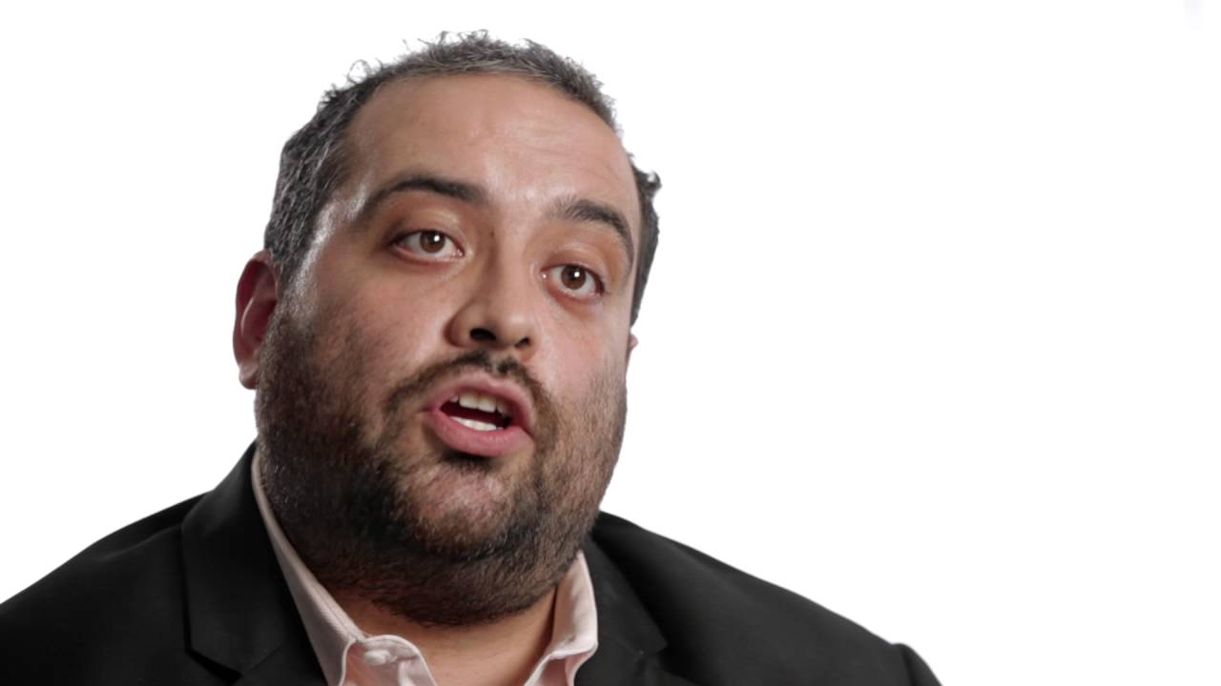
Notes:
Training the Elite: Shamus Khan
https://youtu.be/6ehzUdL8hCw

Slide 31
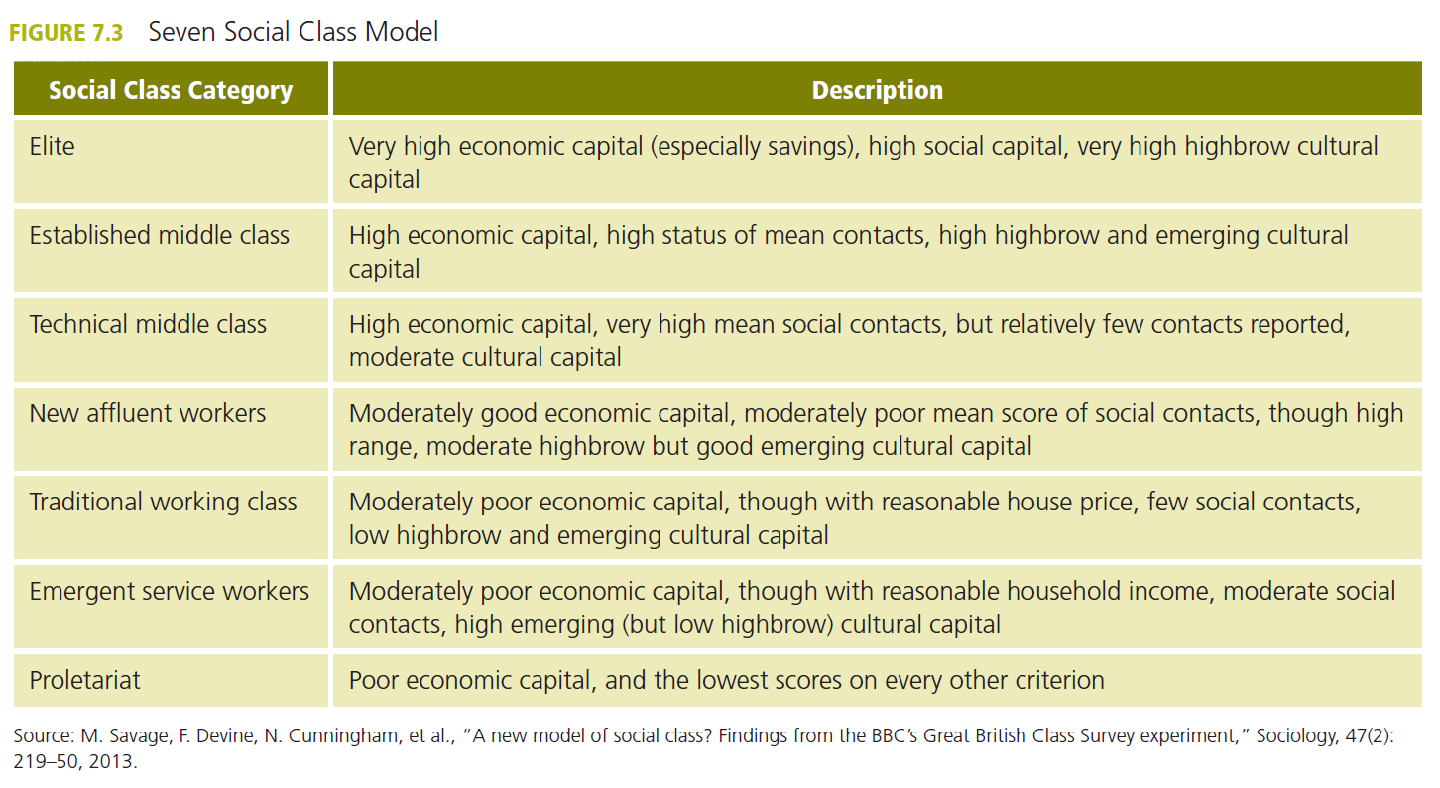
Seven social class model

Slide 32
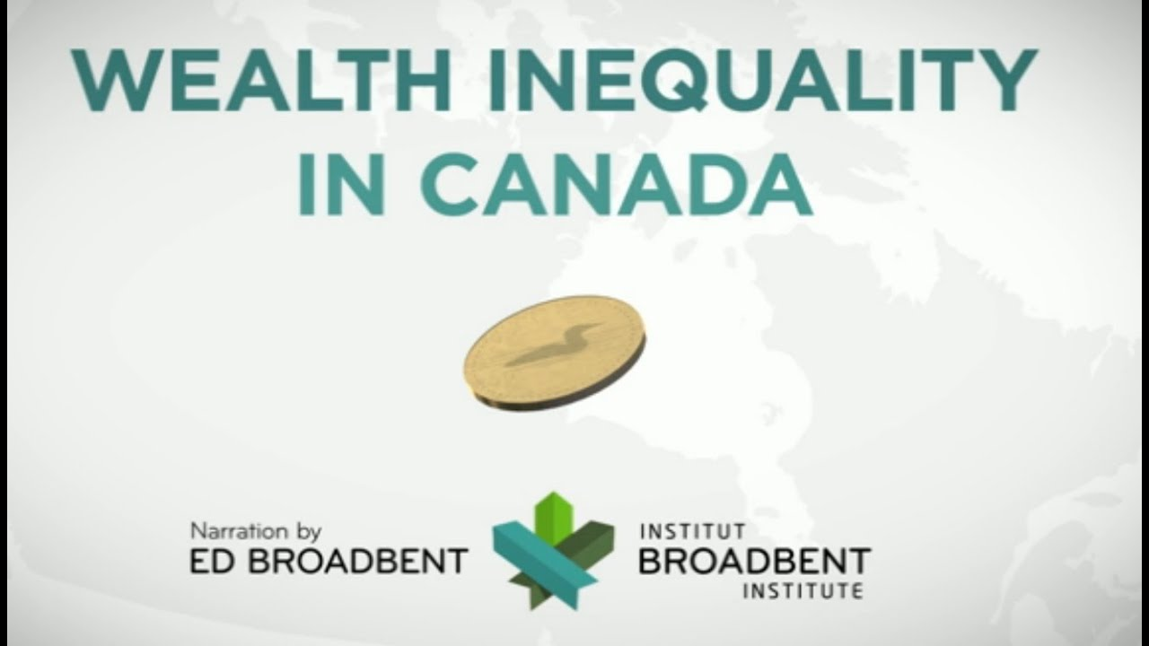
The growth of extreme inequality
Both within most nations and globally, wealth inequality has been growing at an alarming level.
There are concerns that the middle class is disappearing. There are concerns that more of us our struggling to maintain employment. There are concerns that more of us feel a sense of insecurity.
At the same time, a small number of people (CEOs, executives, corporate managers) are seeing their wealth grow at an unprecedented rate.
Image from Video By Broadbent Institute.ca
Notes:
Both within most nations and globally, wealth inequality has been growing at an alarming level.
There are concerns that the middle class is disappearing. There are concerns that more of us our struggling to maintain employment. There are concerns that more of us feel a sense of insecurity.
At the same time, a small number of people (CEOs, executives, corporate managers) are seeing their wealth grow at an unprecedented rate.
https://www.broadbentinstitute.ca/wealth_gap

Slide 33
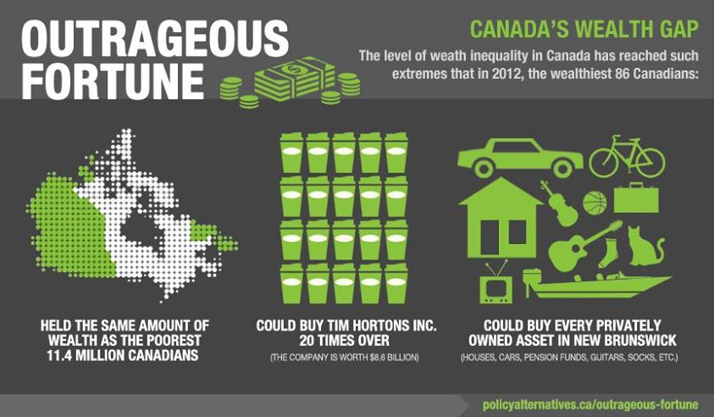
CANADA’s WEALTH GAP
Infographic by CCPA
Notes:
The following videos focuses on Canada, the United States of America, and then the Global Economy
– America is one of the countries where inequality is growing the fastest.
However the pattern is one that can been seen in many countries around the globe.
https://policyalternatives.ca/publications/facts-infographics/infographic-outrageous-fortune-canadas-wealth-gap

Slide 34
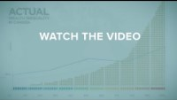
Notes:
Canadian Wealth Inequality
https://youtu.be/zBkBiv5ZD7s

Slide 35
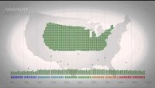
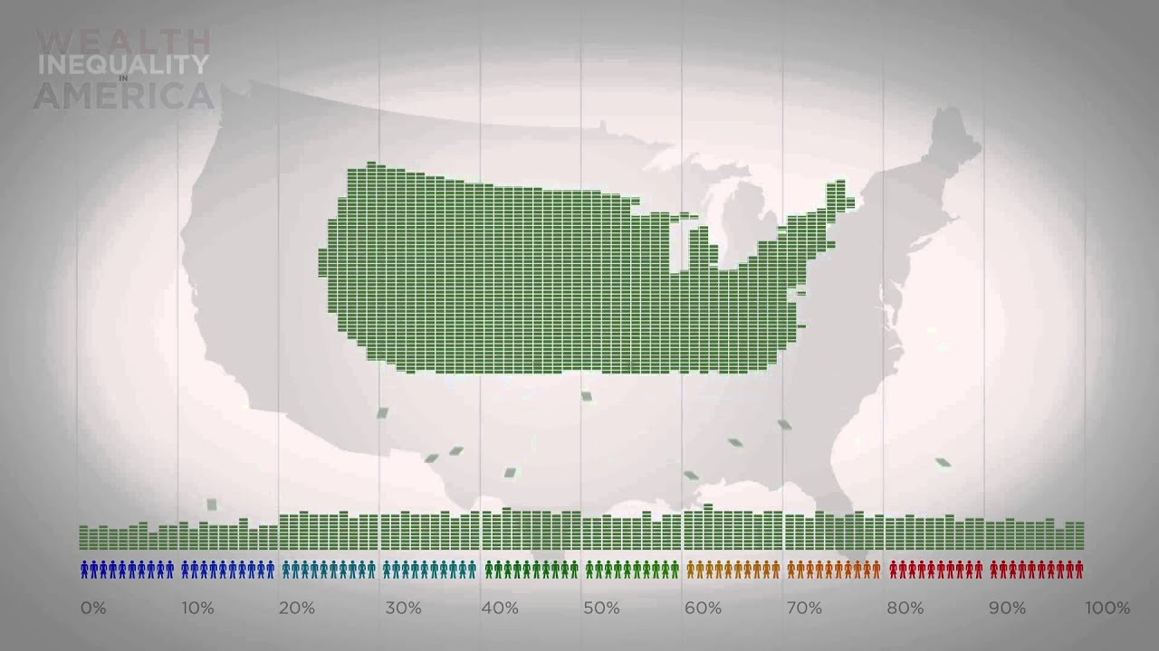
Notes:
American Wealth Inequality
https://youtu.be/QPKKQnijnsM

Slide 36
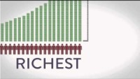
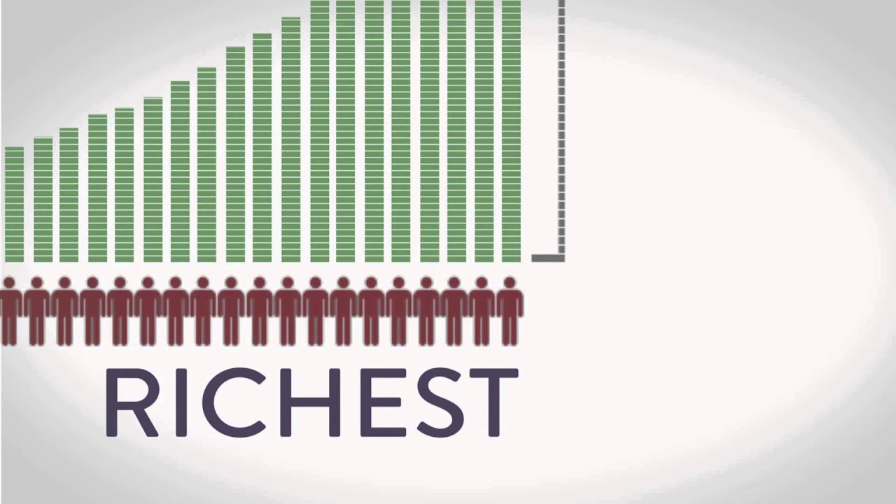
Notes:
Global Wealth Inequality
https://youtu.be/uWSxzjyMNpU

Slide 37
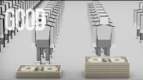

Notes:
100 People – Where do you see your self intersectionally in this
https://youtu.be/QFrqTFRy-LU

Slide 38
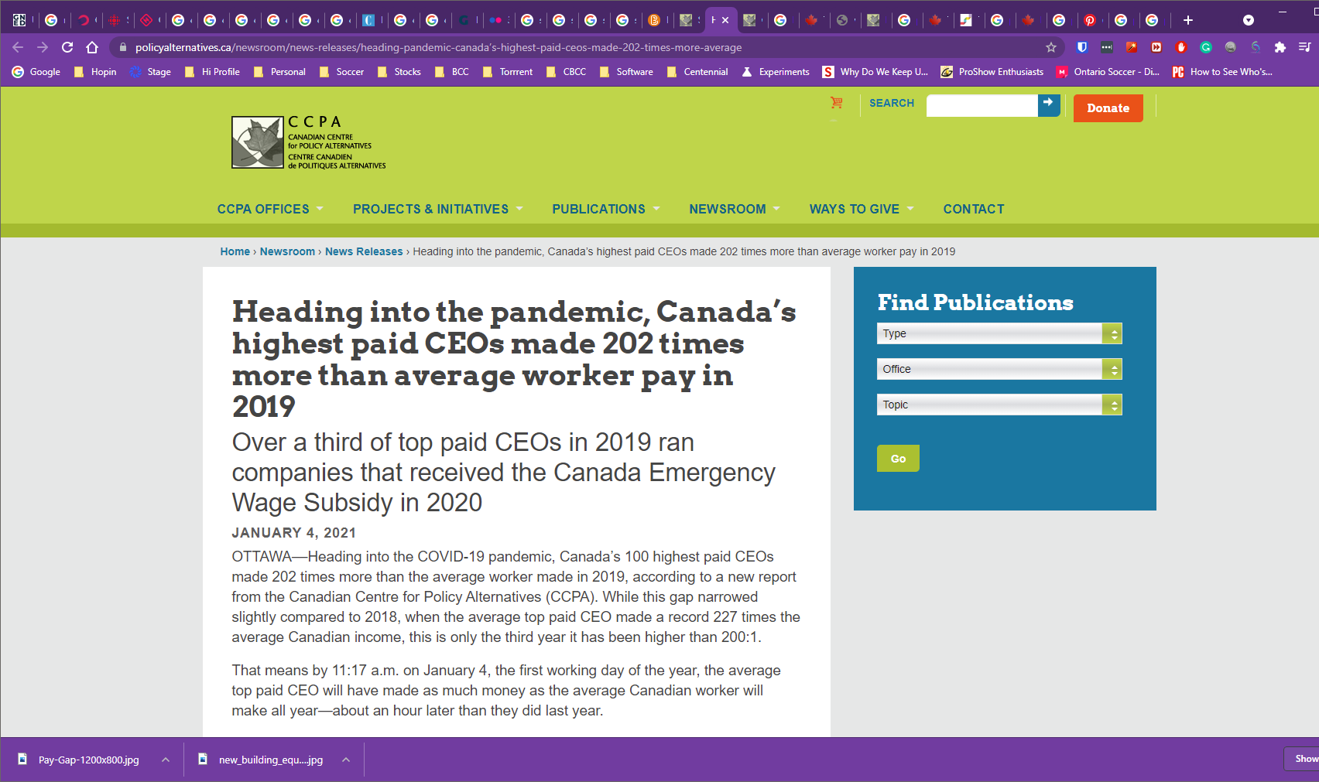
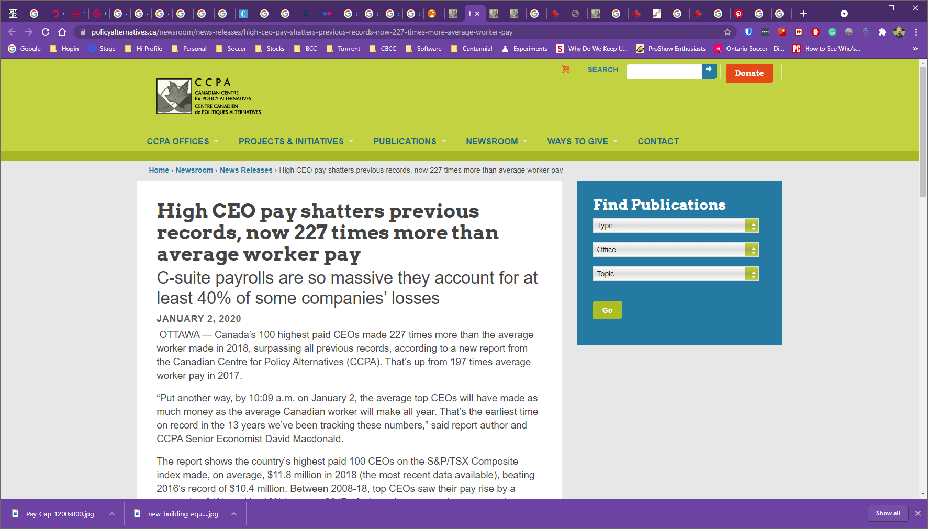
WEALTH GAP CANADA
Notes:
OTTAWA — Canada’s 100 highest paid CEOs made 227 times more than the average worker made in 2018, surpassing all previous records, according to a new report from the Canadian Centre for Policy Alternatives (CCPA). That’s up from 197 times average worker pay in 2017.
“Put another way, by 10:09 a.m. on January 2, the average top CEOs will have made as much money as the average Canadian worker will make all year. That’s the earliest time on record in the 13 years we’ve been tracking these numbers,” said report author and CCPA Senior Economist David Macdonald.
https://www.policyalternatives.ca/newsroom/news-releases/high-ceo-pay-shatters-previous-records-now-227-times-more-average-worker-pay

Slide 39
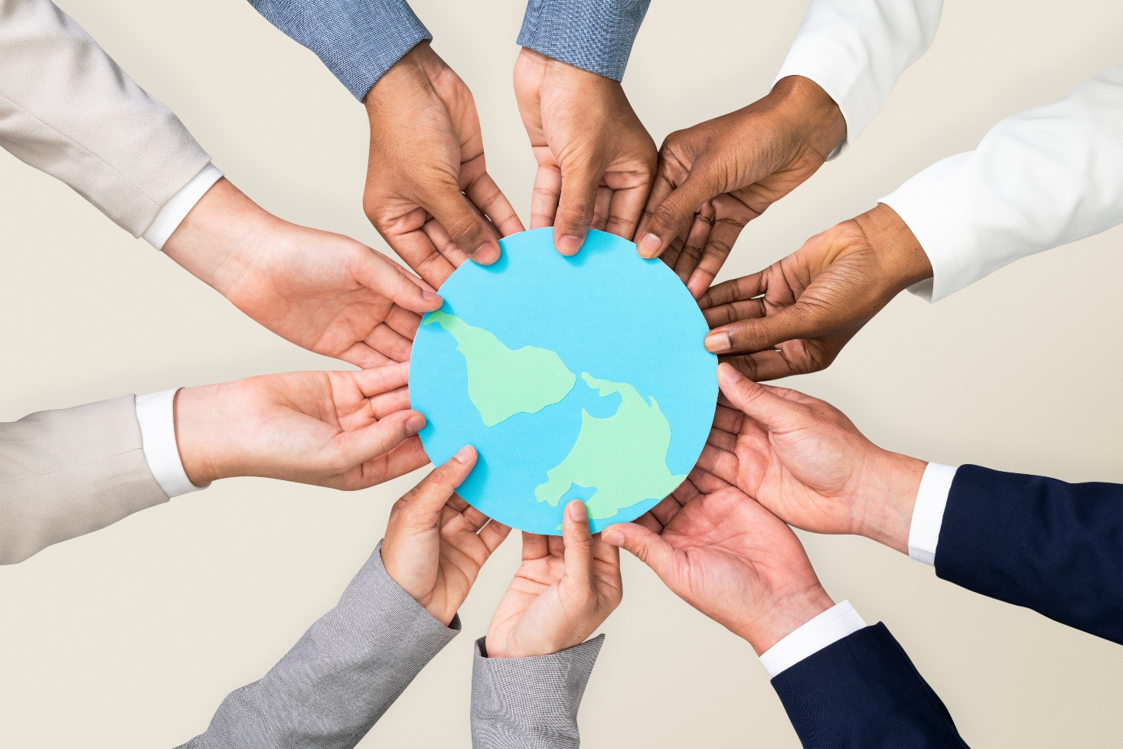
GLOBAL INEQUALITY
Global stratification refers to the hierarchical arrangement of individuals and groups in societies around the world.
Global inequality refers to the unequal distribution of resources among individuals and groups based on their position in the social hierarchy
Image by Rawpixel.com
Notes:
Global stratification refers to the hierarchical arrangement of individuals and groups in societies around the world.
Global inequality refers to the unequal distribution of resources among individuals and groups based on their position in the social hierarchy

Slide 40
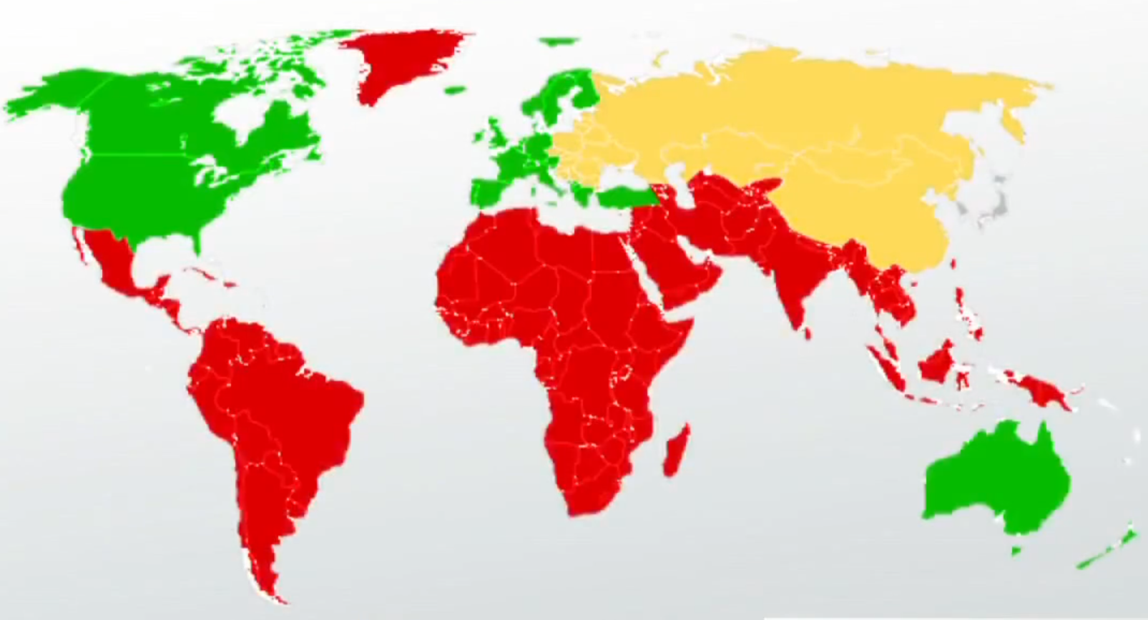
GLOBAL Stratification
For a long time, Americans have used three categories to stratify nations: first-, second-, and third-world.
However, these 'world' categories were socially constructed during the Cold War.
The First World included the U.S. and other capitalist nations.
Communist nations made up the Second World, and the
Third World was everyone else.
These categories were originally based on political ideology. Over time, they started to also be used as economic definitions.
This model does not accurately reflect the uneven distribution of resources and power among nations.
1st World
2nd World
3rd World
Infographic By Erin Long-CrowellGlobal Stratification Definition: Differences in Income Levels and Poverty. (2013, April 16). study.com
Notes:
For a long time, Americans have used three categories to stratify nations: first-, second-, and third-world.
However, these 'world' categories were socially constructed during the Cold War.
The First World included the U.S. and other capitalist nations.
Communist nations made up the Second World, and the
Third World was everyone else.
These categories were originally based on political ideology. Over time, they started to also be used as economic definitions.
This model does not accurately reflect the uneven distribution of resources and power among nations.

Slide 41


QUESTIONS
Question Marks created by Starline - freepik.com
Notes:
Questions …

